Slide 1
Patient Experience Analytics from CAHPS Survey Data
CS 5525 Cloud Computing Project
Spring 2020
Team Members:
Yamini Reddy Dontireddy(16293335)
Satya Anusha Prattipati(16292575)
Madhuri Sarda(16291679)

Slide 2
Objective
The main objective of our project is to analyse CAHPS (Consumer Assessment of Healthcare Providers and Systems) Survey Data for health plans or providers and to gather insights on patient experience when they use employee sponsored or Medicare/Medicaid plans or health care service providers like physicians, hospitals and other healthcare facilities.
Motivation
Patient Experience Analysis would help plans and providers to,
Help measure performance at enterprise, facility and even at service / section level
Measure star rating to comply with CMS compliance for MA plans
Compare against another plan or provider through KPIs such as ranking, mean score and top box score.
Drive improvements and sustain quality of care

Slide 3

Patient Experience
Patient experience encompasses the range of interactions that patients have with the health care system, including their care from health plans, and from doctors, nurses, and staff in hospitals, physician practices, and other health care facilities. Understanding patient experience is a key step in moving toward patient-centered care.
CAHPS Surveys
CAHPS surveys cover topics that are important to consumers and focus on aspects of quality that consumers are best qualified to assess, such as the communication skills of providers and ease of access to health care services. All CAHPS surveys and related documentation are free to anyone who wants to use these surveys to assess patients' experiences with care.
This program was started under CMS (Centre for Medicaid and Medicare Services, a federal health care regulator) since 1995 to quality care in US.

Slide 4
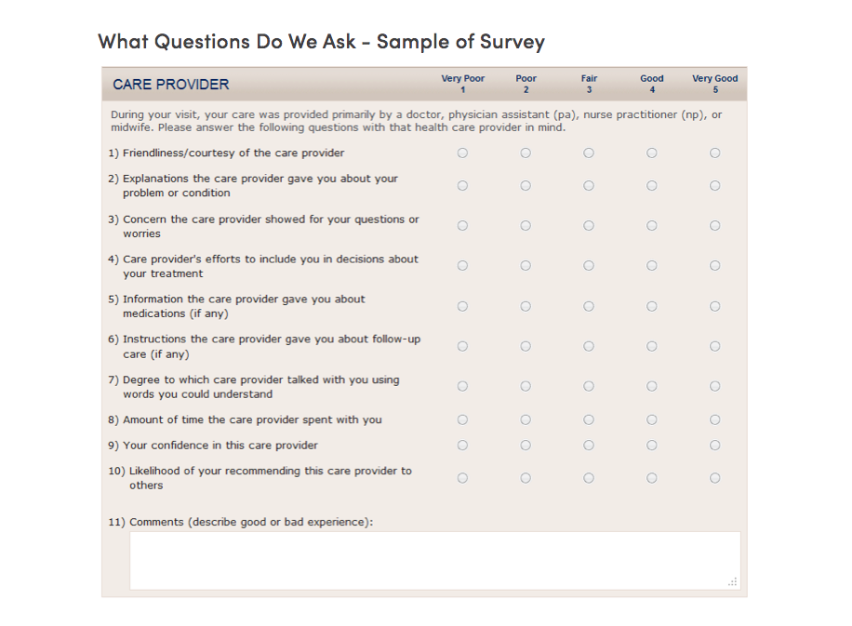
Sample Survey Data Sample

Slide 5
Architecture Design
Architecture
Technologies
User
Interface
Patient Experience
Power BI or Angular
Power BI from Microsoft Or Azure Office (based on license)
Dashboard 1
Dashboard 2
Services &
Data Access
Microsoft Azure Cloud
Direct Read from BI
Power BI Data Access connector to Azure SQL or ML Studio based on license
Data
“Survey DB”
(New Azure DB)
Azure SQL on Azure cloud

Slide 6
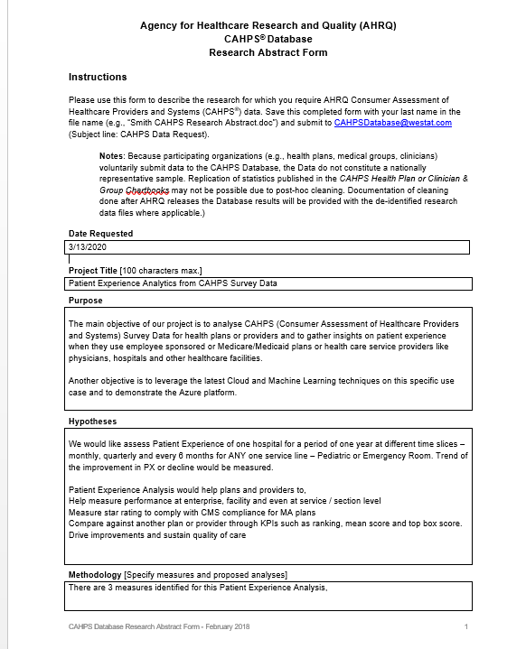
Mid Point - Check
Dataset Gather Datasets from CHAPS.

Slide 7
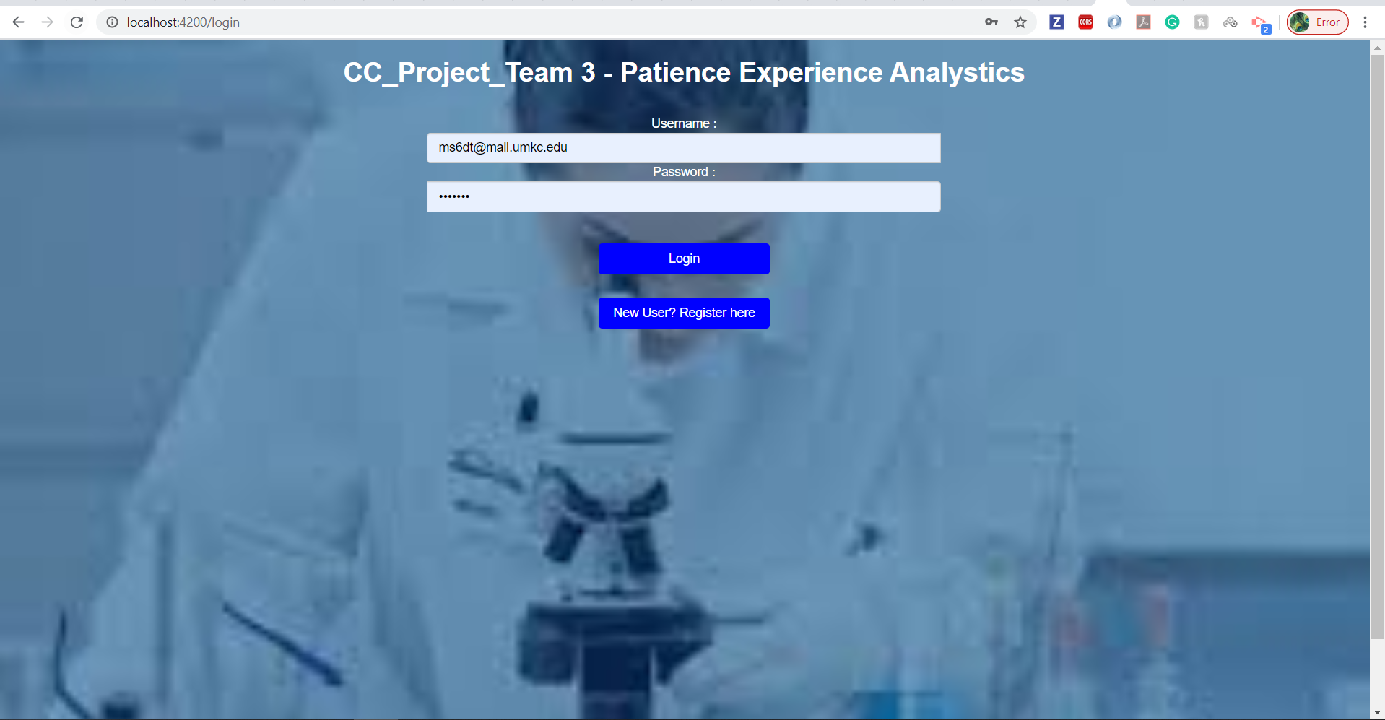
Mid Point – Check Sign-in Page

Slide 8
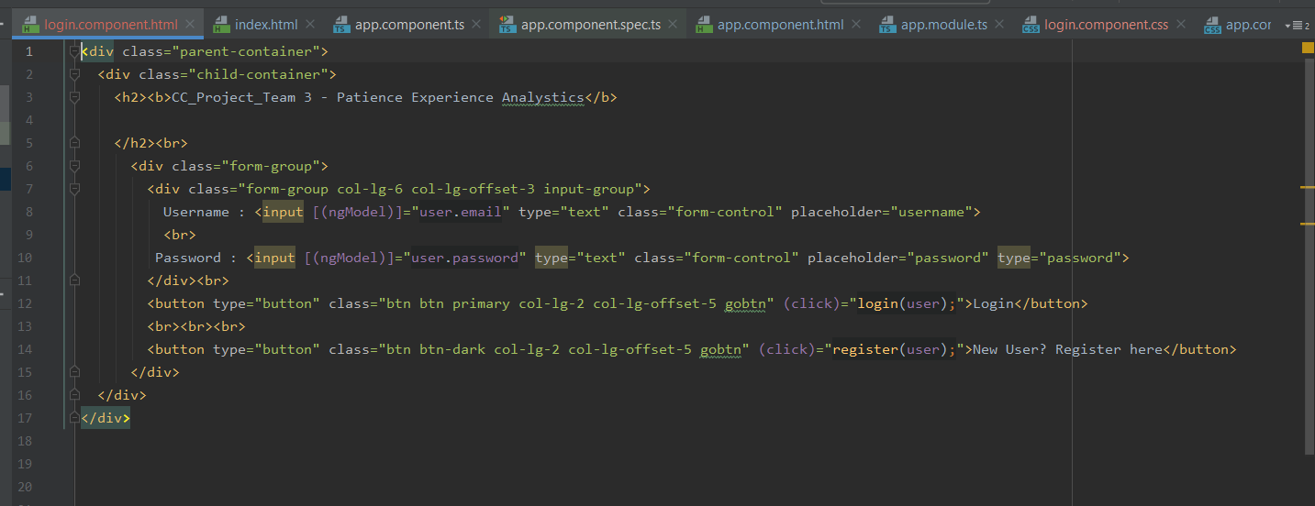
Angular Code:

Slide 9
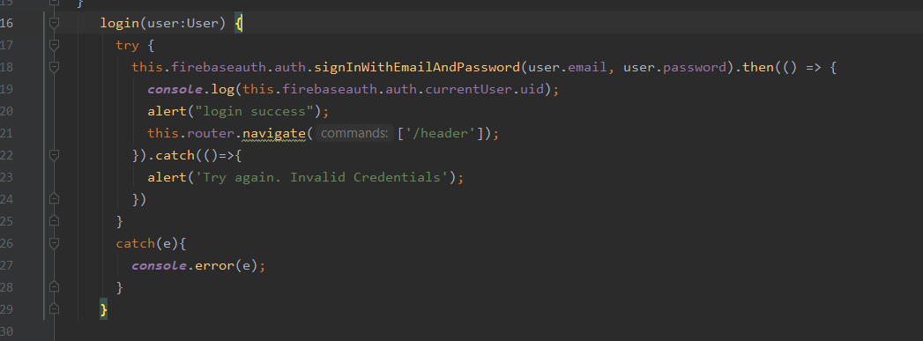
Continuation:

Slide 10
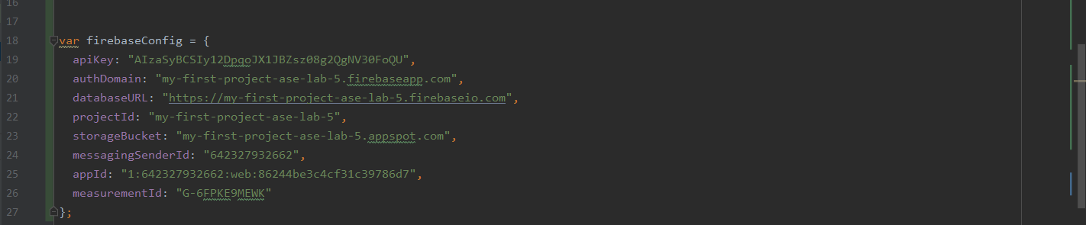
FireBase Configuration

Slide 11
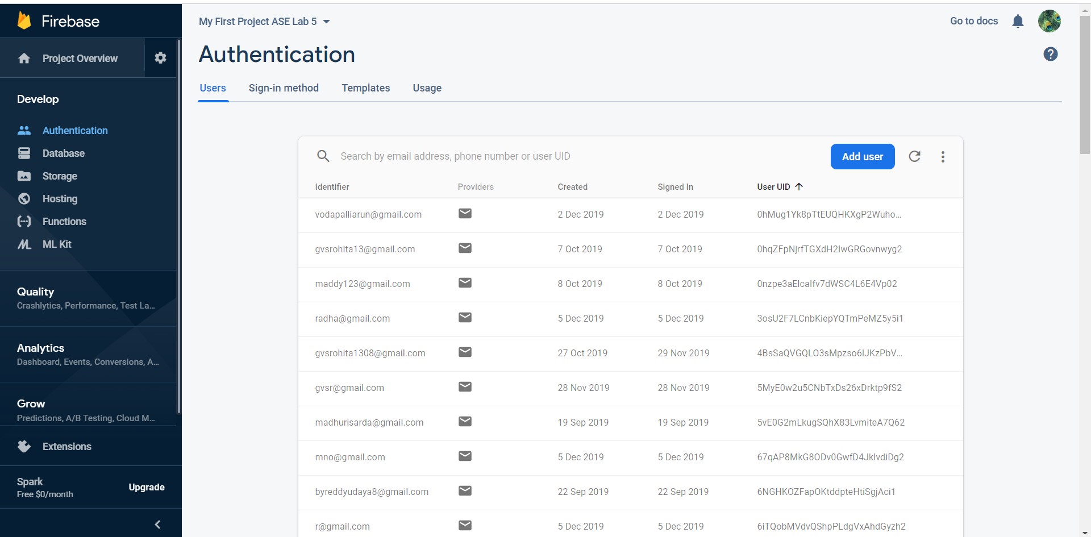
Registered Users in FireBase

Slide 12
Mid Point - Check
Analysis - Analyzing Requirements for Patient Experience – Identify service line, facility and data set
Surveys are initiated once the patient gets discharged from any hospital or diagnostic facility. This can be large hospital or medical practice or emergency room and even ambulatory/hospice care providers.
Surveys are accessed by Patients through multiple channels – IVR, Postal mail, online, esurvey etc. based on the customers preference and consent.
Responses are collected & aggregated for each patient based on the discharge date or survey response dates
Responses are aggregated at different levels such as servicelines, facility, enterprise and also across various time spans such as monthly, quarterly and annual. Compared with previous period (In Scope) and its peer group (Not in Scope).

Slide 13
Mid Point - Check
KPI Definition Define Key performance measures for analyzing patient experience
Top Box Score
Question-level scores are calculated by taking the number of responses in the most desirable response category and dividing it by the total number of responses, excluding ignore values. Question-level n is determined by the number of respondents who answered that question.
Mean Score
The n of a question is the total number of responses to the question. The n of a section is the total number of unique responses in that section (i.e., not the sum of question responses). The overall n is the total number of unique responses and mean is calculated taking the average of all the responses.
Percentile Distribution
This would calculate the percentage distribution of CHAPS survey responses across various 5 categories.

Slide 14
Mid Point - Check
KPI Definition Define Key performance measures for analyzing patient experience

Slide 15
Mid Point – Check Viz 1: Mean score of Ambulatory service line for last 4 quarters.
This visualization will help the provider understand in Q3 they have done well (99.1 mean score)

Slide 16
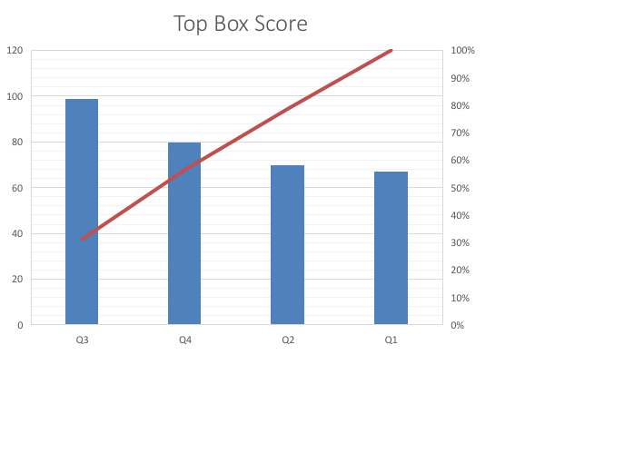
Mid Point – Check Viz 2: Top Box score of Ambulatory service line for last 4 quarters.
Quarter | Top Box score
Q1 | 67.2
Q2 | 70.1
Q3 | 99.1
Q4 | 80.1

Slide 17
Mid Point – Check Challenges
As it’s a survey data, it was bit hard to analyze.
It really took lot of time to understand and to segregate and finalize the metrics for the data.(Coming up with proper statics was challenging)
All of the team members are new to Power BI to build the viz , and it took bit long to understand and build wizards.

Slide 18
Mid Point – Check Next Steps
Further Analysis of the survey data for various service lines (Emergency etc)
Develop 2 complete dashboards with multiple wizards(Viz).
Complete end to end integration of the application.
Professor/TA feedback action items.

Slide 19
Project & Collaboration Plan
Activity / Phase | Description | ETA | Responsible | Comments
Project Plan
Analysis | Analyze CAHPS Survey data, define KPIs performance measurement | Done | Anusha, Madhuri, Yamini
Design | Design tables, visual charts/components – High level design | Done | Anusha, Madhuri, Yamini
Development | Define tables, data access layer, and visual dashboards and charts | April 18th | Anusha, Madhuri, Yamini | 20% od development is done. Just 2 viz are designed.
Validation | Review KPIs and validate the results in dashoards | April 20th | Yamini, Anusha
Project Presentation | Configure the prototype in Azure cloud for presentation along with slides. | TBD | Anusha, Madhuri, Yamini | Give timelines are tentative.
Project Plan
Design Sessions | Meet daily 1 hr to anlyze survey data to define tables, charts and dashboards | Daily | Anusha, Madhuri, Yamini | Daily till design is completed.
Meeting | Weekly meeting to review progress on respective deliverables of each member | Weekly | Anusha, Madhuri, Yamini

Slide 20
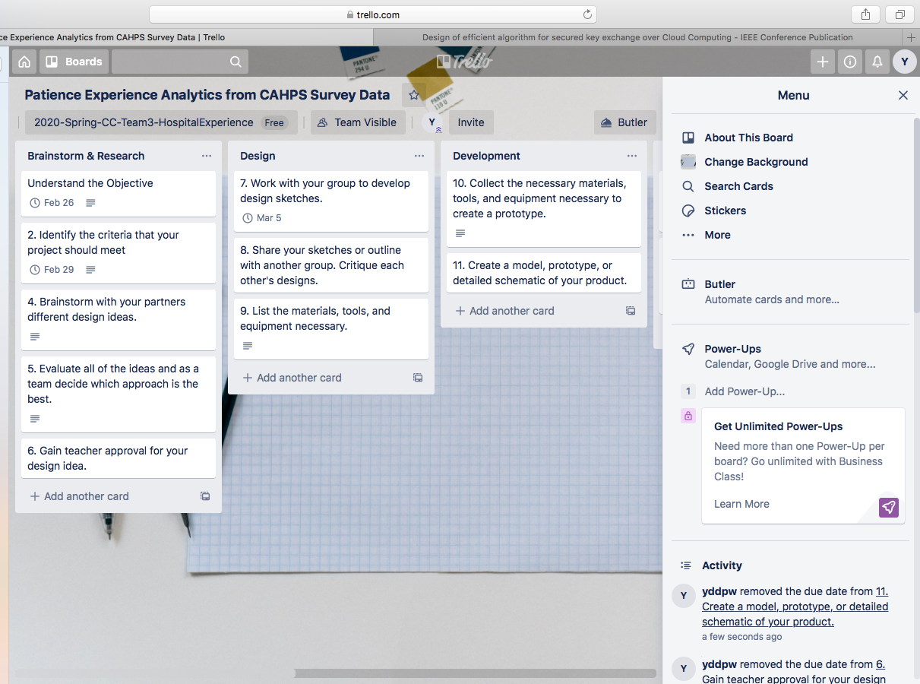
Trello Dashboard & Github Link
Github Link : https://github.com/madhurisarda/CS5525CloudComputing

Slide 21
Patient Experience Vs Patient Satisfaction - The terms patient satisfaction and patient experience are often used interchangeably, but they are not the same thing. To assess patient experience, one must find out from patients whether something that should happen in a health care setting (such as clear communication with a provider) actually happened or how often it happened.
Satisfaction, on the other hand, is about whether a patient’s expectations about a health encounter were met. Two people who receive the exact same care, but who have different expectations for how that care is supposed to be delivered, can give different satisfaction ratings because of their different expectations.

Slide 22
References
https://healthdata.gov/dataset/patient-survey-ich-cahps
https://www.ahrq.gov/cahps/cahps-database/index.html
https://www.sgim.org/communities/research/dataset-compendium/consumer-assessment-of-healthcare-providers-and-systems-cahps#

Slide 23
Thank you

